Slide 1
Advanced KPI Forecasting and Analysis

Slide 2
The team
Project Lead
Wes Warman
Report Lead
Data Lead
Engineering Lead
Modelling Lead
Feyre Gezahegn
Saul Chirinos
Muhammad Usman Khan
Yutong Liu

Slide 3
Introduction
Learning objectives were set to provide insights about how creatives will perform in market
Received panel data with over 13,000 observations and 17 defining features
Used data exploration to understand the data better and build a workable prediction tool

Slide 4
Learning Objectives
PRIMARY
Most important features
Find optimal mix of creatives per Funnel & Publisher
Impact of number of creatives in market on performance
SECONDARY
Application of model outputs;
Identify best practices; &
Identify additional data to collect

Slide 5
Challenges deep-dive
Challenge 1
Challenge 2
Challenge 3
Performance Trend Line
Time series forecasting was a challenge with panel data
Normalizing weeks
Challenging to write the code for the transformation
Advanced Packages
Many of the advanced ML packages available on Python (Pycaret, Prophet) did not install

Slide 6
Presentation Outline
The rest of the presentation will proceed as follows:
Saul
Wes
Muhammad
Exploratory data analysis (EDA)
Modeling and prediction results
Graphical user interface

Slide 7
Exploratory Data Analysis
Primary Learning Outcomes

Slide 8
PLO: Optimal mix of creatives per Funnel + Publisher
Creatives grouped by: Publisher, LOB, Product, KPI audience

Slide 9
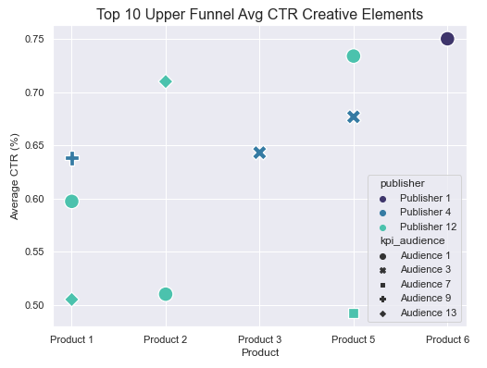
Click Through Rate
PLO: Optimal mix of creatives per Funnel + Publisher
Creatives grouped by: Publisher, LOB, Product, KPI audience

Slide 10
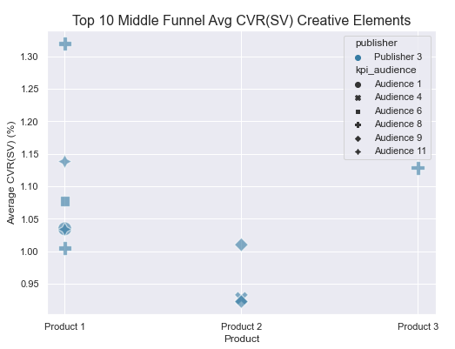
Click Through Rate
Site Visit Conversion Rate
PLO: Optimal mix of creatives per Funnel + Publisher
Creatives grouped by: Publisher, LOB, Product, KPI audience

Slide 11
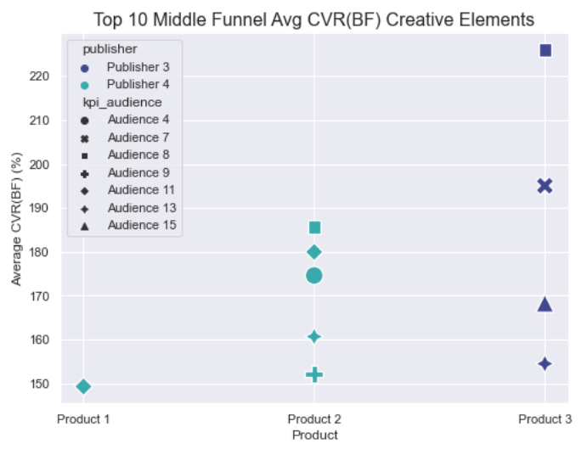
Buy Flow Entry Conversion Rate
PLO: Optimal mix of creatives per Funnel + Publisher
Creatives grouped by: Publisher, LOB, Product, KPI audience

Slide 12
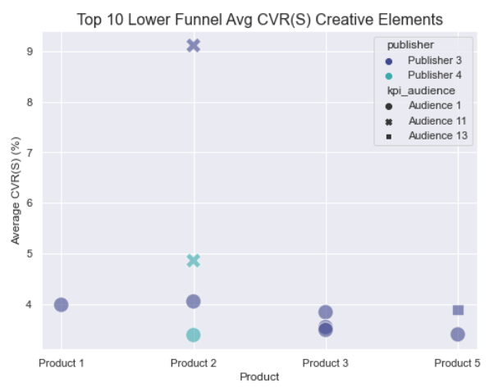
Buy Flow Entry Conversion Rate
Sales Conversion Rate
PLO: Optimal mix of creatives per Funnel + Publisher
Creatives grouped by: Publisher, LOB, Product, KPI audience

Slide 13
PLO: Impact of number of creatives in market on performance

Slide 14
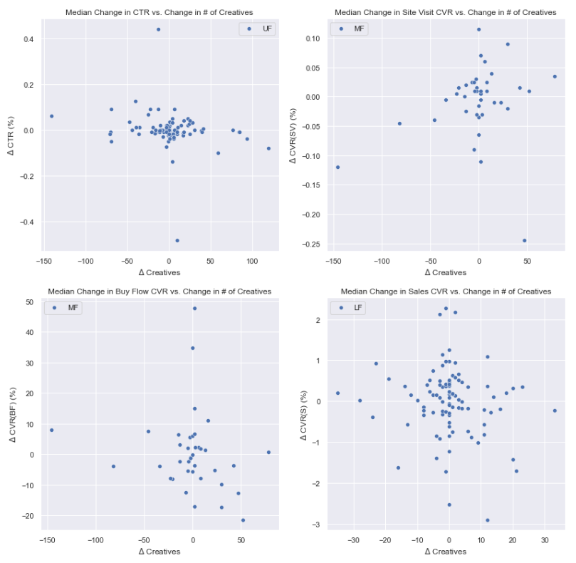
PLO: Impact of number of creatives in market on performance
Estimation equations

Slide 15
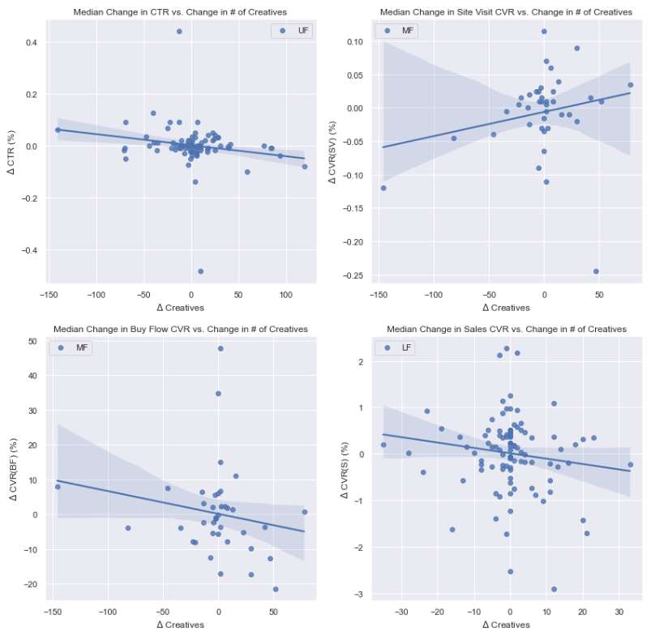
PLO: Impact of number of creatives in market on performance
Estimation equations

Slide 16
PLO: Most important factors and their impact towards KPI prediction

Slide 17
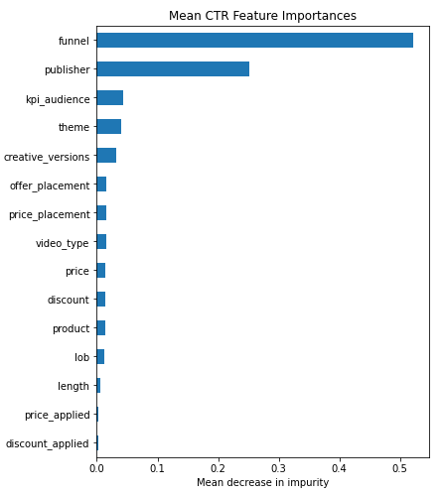
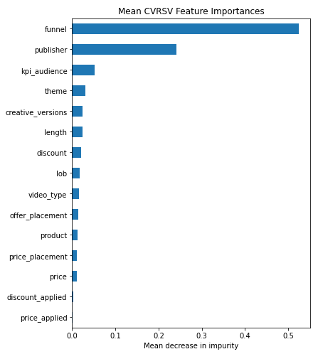
PLO: Most important factors and their impact towards KPI prediction
Results from Random Forest model

Slide 18
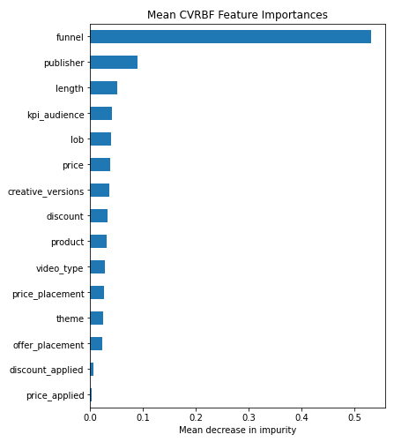
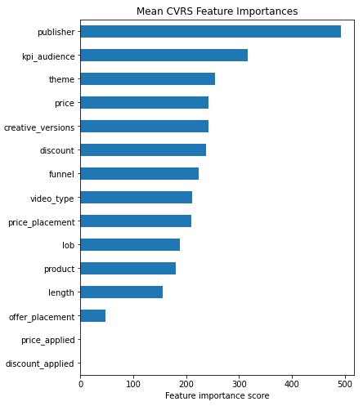
PLO: Most important factors and their impact towards KPI prediction
Results from Random Forest model
Results from Light Gradient Boosting Machine model

Slide 19
Additional analysis

Slide 20
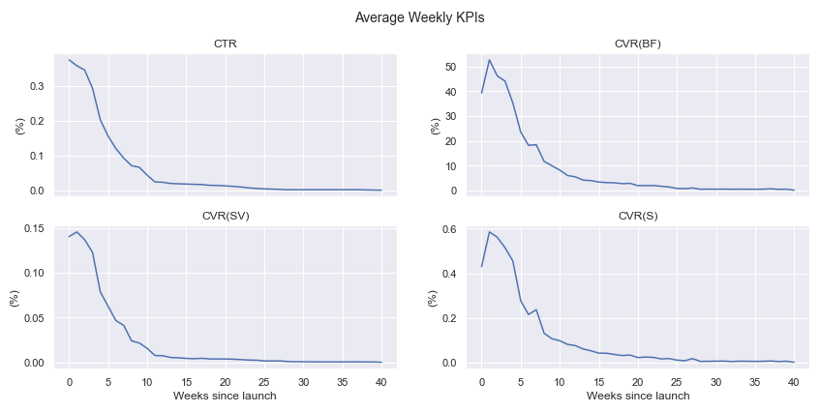
Additional analysis

Slide 21
Modelling

Slide 22
Model Choice
For CTR and CVRSV we limited our data to only social
We included all channels for predicting CVRBF and CVRS
Random Forest Regression was chosen as the top performing model
However, LGBM performed better for predicting CVRS

Slide 23
Average CTR
Row/Creative | Actual | Predicted
1 | 0.34 | 0.31
2 | 0.27 | 0.26
3 | 0.07 | 0.07
4 | 0.24 | 0.23
5 | 0.02 | 0.03
R2 | 0.81
MAE | 0.036

Slide 24
Average CVRSV
Row/Creative | Actual | Predicted
1 | 0.39 | 0.42
2 | 0.32 | 0.30
3 | 0.79 | 0.72
4 | 0.11 | 0.13
5 | 0.12 | 0.05
R2 | 0.68
MAE | 0.12

Slide 25
Average CVRBF
Row/Creative | Actual | Predicted
1 | 7.97 | 7.5
2 | 0.30 | 0.92
3 | 0 | 0.26
4 | 0.73 | 0.61
5 | 0 | 1.2
R2 | 0.61
MAE | 0.97

Slide 26
Average CVRS
Row/Creative | Actual | Predicted
1 | 0 | 0.01
2 | 0.03 | 0.02
3 | 0 | 0.16
4 | 0.40 | 0.17
5 | 0.21 | 0.06
R2 | 0.44
MAE | 0.27

Slide 27
Modeling Takeaways
As we moved down the funnels, our predictive power got weaker
We improved our results for the lower funnels by including all channels (more data)

Slide 28
Graphical User Interface

